Slide 1
Chapter 9
Peripheral Interface

Slide 2
Introduction
Processor is just a computing device.
It computes what is expected of it and transfers it to the outside world.
Memory management form8086 is done by using the read and write control signals and I/O is accessed using these signals.
I/O devices are of different varieties, functions, features, specifications and so on.
As 8086 does not have the requisite hardware within it to manage each of them according to their special requirements and specifications.
I/O devices need some extra hardware to let them be interfaced to the processor.
In this context that various interfacing chips have been designed.

Slide 3
1. Trainer Kit
Current PCs do not have 8086 processor, so we cannot use the PC for a first level understanding of interfacing
PCs use many interfacing chips in its chipset
We will try to understand the idea of interfacing by the use of a trainer kit which have been designed for educational purposes.
It has all hardware and software components for “training”
Trainer kit has following features
1. Intel 8086 CPU at 4.77 MHz clock speed
2. 16KB for monitor EPROM upgradable to 64KB
3. 16KB RAM expandable to 64KB
4. Standard RS232C compatible serial port brought out to a 9-pin D-type male connector
5. 3 channel 16-Bit counter/timer using 8253 terminating in an I/O pin connector

Slide 4
6. Fully buffered address, data and control signals terminated at a 50-pin header for interfacing
7. 8 nos. of interrupt lines brought out to a 10-pin connector using 8259 programmable interrupt controller
8. Serial communication package to link PC and a kit

Slide 5
2. Programmable Peripheral Interface (PPI)
It is also called as Parallel Port Chip.
To ease out the problem & issues related to parallel data transfer
we have transferred 8/16 bits at one go either to/from memory or I/O devices as per previous chap
when I/O devices are more versatile & have more features, a PPI is very useful
If it is used then no extra H/W is required to interface peripheral devices that perform parallel data transfer.
The chip 8255A is a more advanced version of 8255 to refer as parallel port chip.

Slide 6
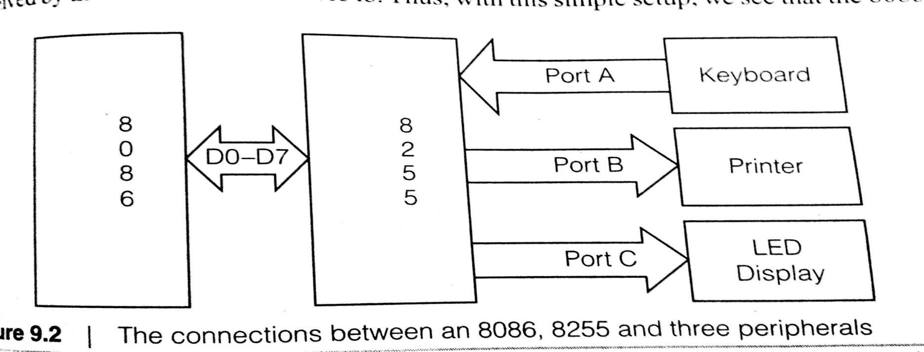
Using of 8255
Why is this chip necessary in 1st place & Why is it used.
figure shows the connection between 8086, 8255 and three peripherals
Data bus of the 8086 is connected to 8255
Means data transfer between 2 chips is possible
where does the 8255 keep the data?
Answer is that it has registers called “Ports”.

Slide 7
3-ports _ A, B & C
ports has pins connecting to external devices
to these port pins external devices like Keyboard, Printer to be connected.
Previous figure shows that set of LED connected to Port C & a printer to a Port B.
means data from 8086 can be transferred to O/P devices
routed through these ports of 8255.
to do these we need to program Port B & Port C as O/P ports.
Port A has Keyboard connected to it.
This means Port A is to be programmed as an I/P port. So keyboard can send data to it as received by 8086
with this we can say 8086 has been interfaced using 8255 as a temporary storage space.

Slide 8
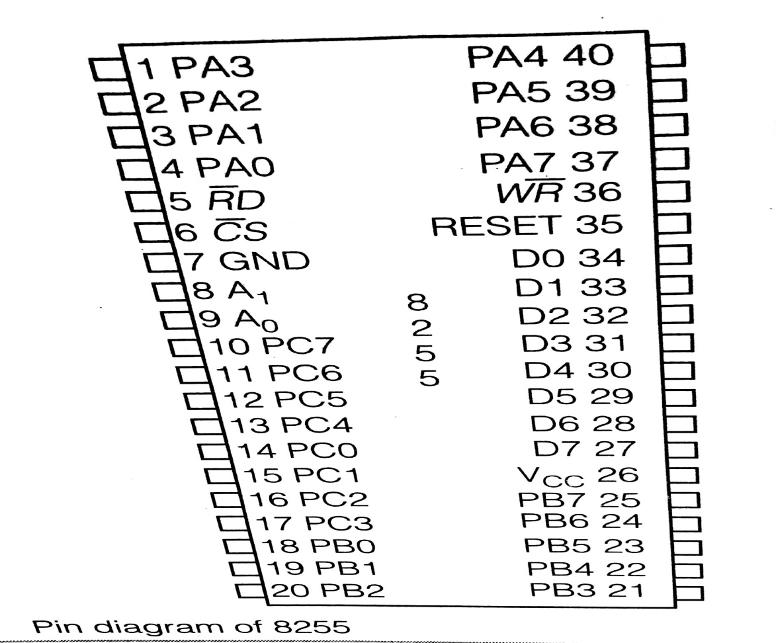
2.1 Pin configuration & Internal Block diagram
It has 40 pins
of which 3 8-bit Ports A, B, C are programmed to I/P or O/P ports
Figure shows inter block diagram of the chip consisting of various functional blocks.

Slide 9
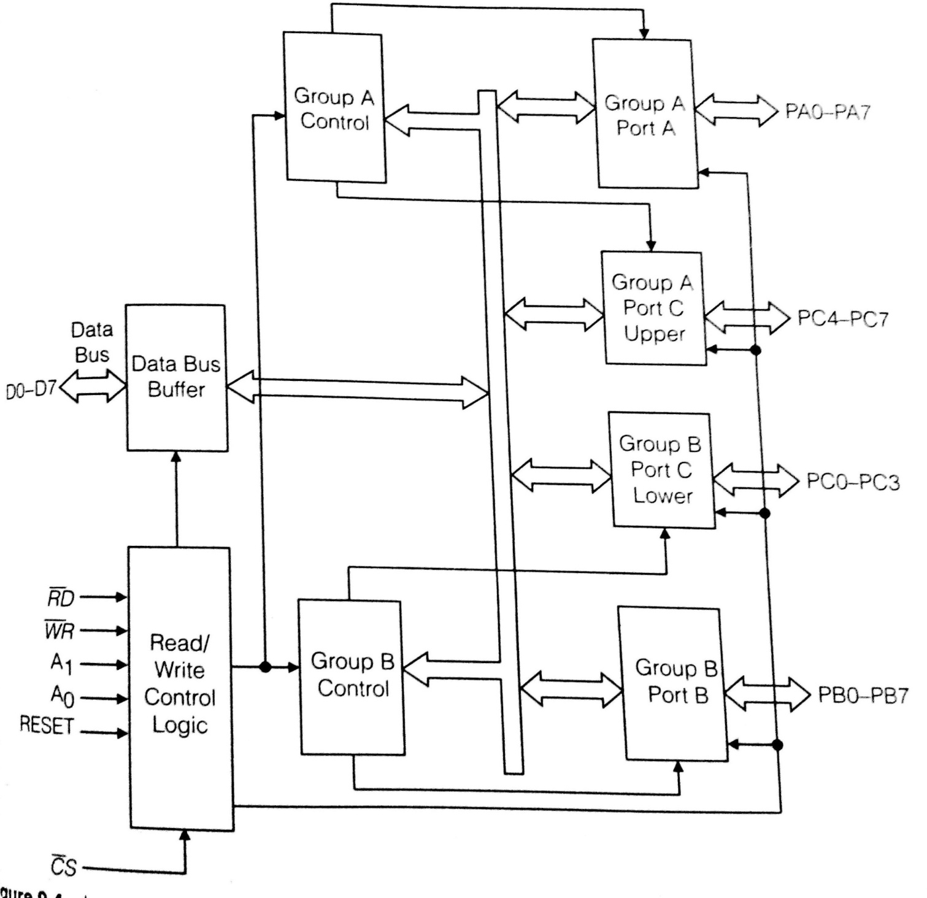
figure shows the internal block diagram of 8255

Slide 10
Data Bus Buffer
3 state bi-directional 8-bit buffer used to interface the chip to the data bus of the system
upon execution of the processor’s I/P or O/P instruction, data & control status are received or transmitted to buffer.

Slide 11
Read/Write control logic
Manages all data transfer between chip and the processor on accepting control signals from the control and address bus of the system

Slide 12
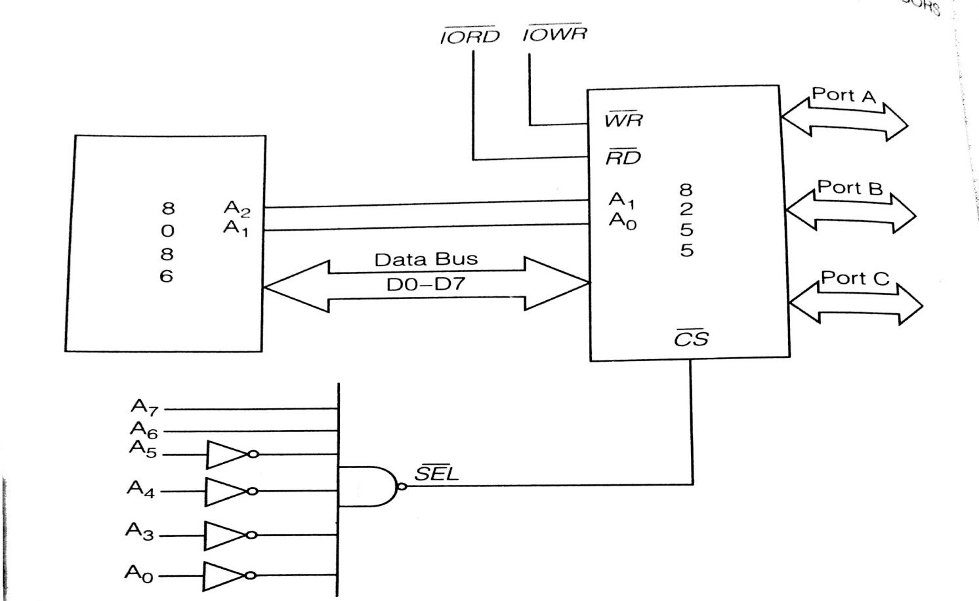
Group A & B Controls
Functionally, chip has been divided as Group A & B and they have their corresponding controls.
lets see what this grouping is intended for.
the way the chip is to act is decided by a register called the control/status register that can read from & write to.
see the typical connection between the 8086 & an 8255 below

Slide 13
lower data lines of the chip can be connected to 8 bits of the data bus of the 8086
the RD and WR are connected to the IORD and IOWR generated form the 8086
If this chip is to have only an eight-bit address, only the lower 8 lines of the address lines of the processor need to be involved in the address decoding process, that causes CS lines to be activated.
else 16 address lines may be used
Any two address pins of the processor are to be connected to the pins A0 and A1 of the 8255
this is because there are four separate entities associated with this chip, and each one needs a unique address.
this is achieved by the four possible combinations of these two lines as table shown next

Slide 14
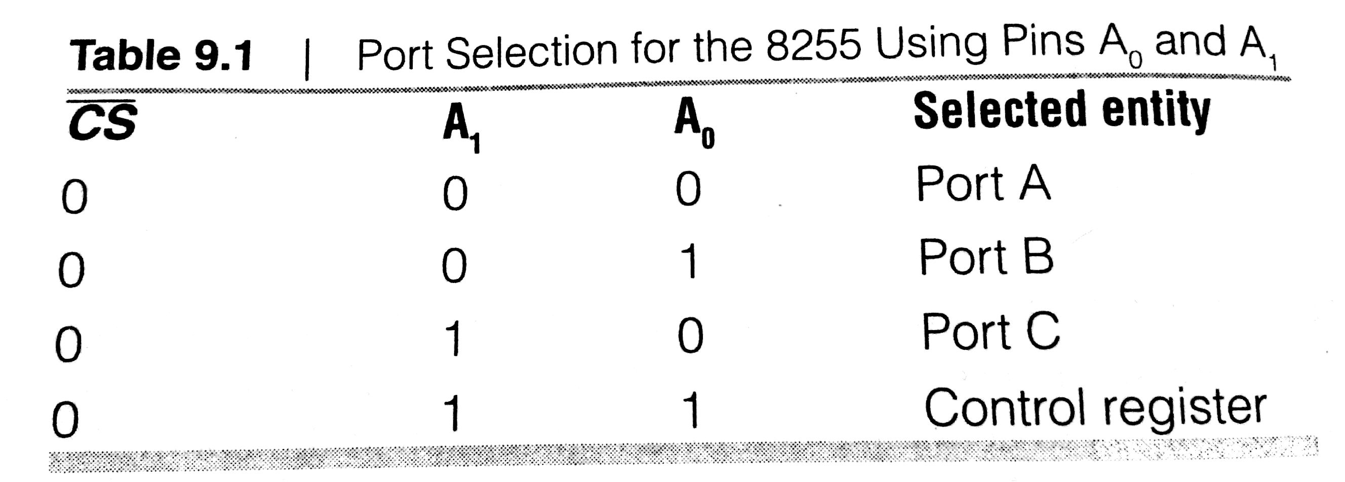

Slide 15
2.2.2 Programming the PPI
How is the chip programmed & what options are available?
Programming the chip involves only the writing of a particular word to the control register.
the control-register is an 8-bit register that can be written into.
the bits of these (called the control word) will decide the way of the port to be configured
Figure 9.6 understands the control word format
As seen in diagram, the ports A, B & C are grouped into two- Groups A & B.
Group A consists of Port A and upper bits (PC4 – PC7) of Port C
Group B consists of Port B and Port C lower (PC0 – PC3)

Slide 16
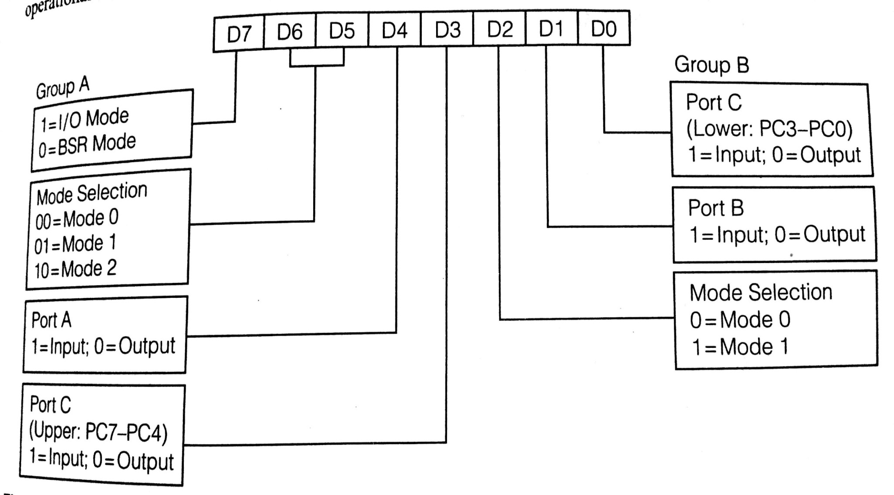
Control word format of 8255
Group A ports can have three operational modes (0, 1, 2), but Group B ports have only two modes of operation.

Slide 17
Bit assignment of the control word:
D7 suggests the options of I/O mode or BSR mode.
to see, lets use the chip in the I/O mode as normal mode of operation
next thing to do in this is to decide the mode of operation of the two groups
It is acceptable for the two groups to be in different or same modes
After this is done, select the option of a particular port being either an input or output port.
for I/P the corresponding bit is to be 1, and for output it is to be 0.

Slide 18
3 Modes of Operation
8255 can be made to work in three modes as decided by the system designer. They are:
Mode 0: Basic input/output
Mode 1: Strobed input/output
Mode 2: Bi-directional bus
Mode 0: simplest and most widely used mode. Here two 8-bit ports A & B and the 4-bit ports Port C (upper & lower) may be used independently. Here data is simply taken in from an input port or given to an output port
Mode 1: It is an ‘Handshaking’ mode. Handshake implies data transfer in which the communicating devices exchange request and acknowledge control signals with each other. In 8255 operating in this mode, port A & B pins are used for data transfer, while 4 bits of each Port C are used for generating the handshaking signals for each of the 8-bit ports.

Slide 19
Mode 2: This is the bidirectional mode. Only Group A can use this mode. Here, port A is used for transmitting as well as receiving data. Handshaking signals generated by the upper 4 bits of Port C maintain bus discipline for proper flow of data in the required direction.

Slide 20
4. Mode 0
The specification of this mode are:
1. Two 8-bit and two 4-bits ports
2. Any port can be input or output
3. Outputs are latched
4. Inputs are not latched
5. 16 different input/output combinations possible
check examples 9.2, 9.3 etc...

Slide 21
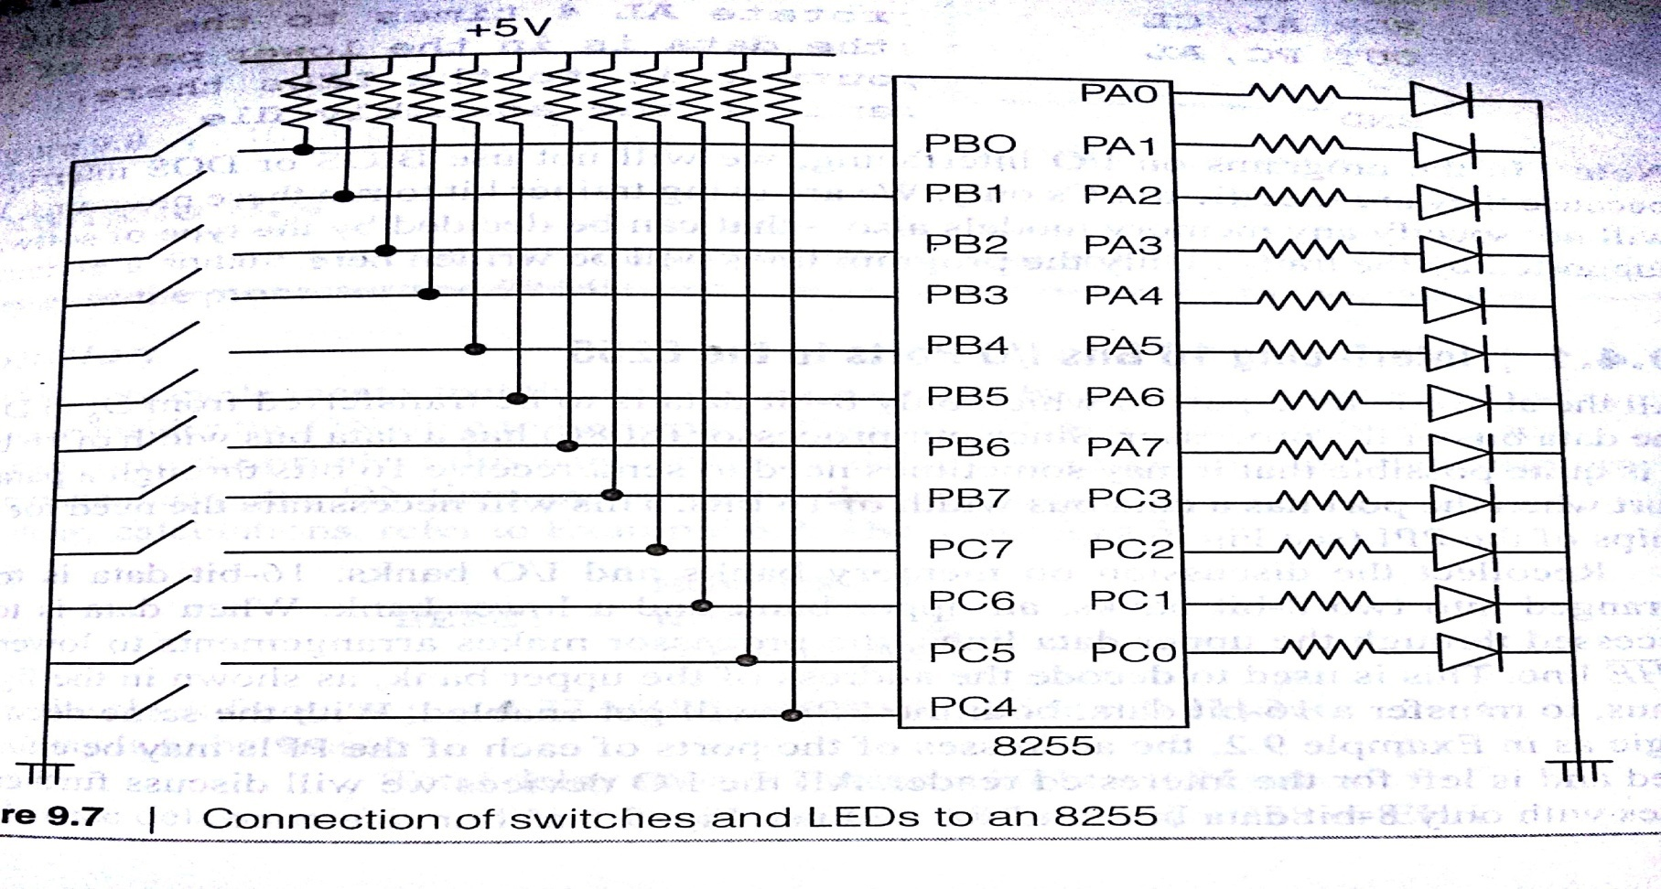
Following figure shows how 8 switches that are connected to Port B and Port CU . When a switch is closed, a ‘0’ is read in, and when it is open, a ‘1’ is read into the port lines. To the pins of port A and Port CL connect 12 LEDs along with their current limiting resistors. The LEDs glow when the corresponding pins have a high logic on them.

Slide 22
Lets discuss the steps in the program that will be run:
i. The ports & the control register addresses have been given labels and will be specified using the EQU directive. As port addresses are 8 bits long, fixed port addressing can be used.
ii. The switch settings at the input Port B can be read in directly and transferred to the output Port A.
iii. The data at Port CU can be read in by inputting Port C fully, but the switch settings will be available only at the upper 4 bits position and have to be shifted to the position of the lower 4 bits to output it to the LEDs.

Slide 23
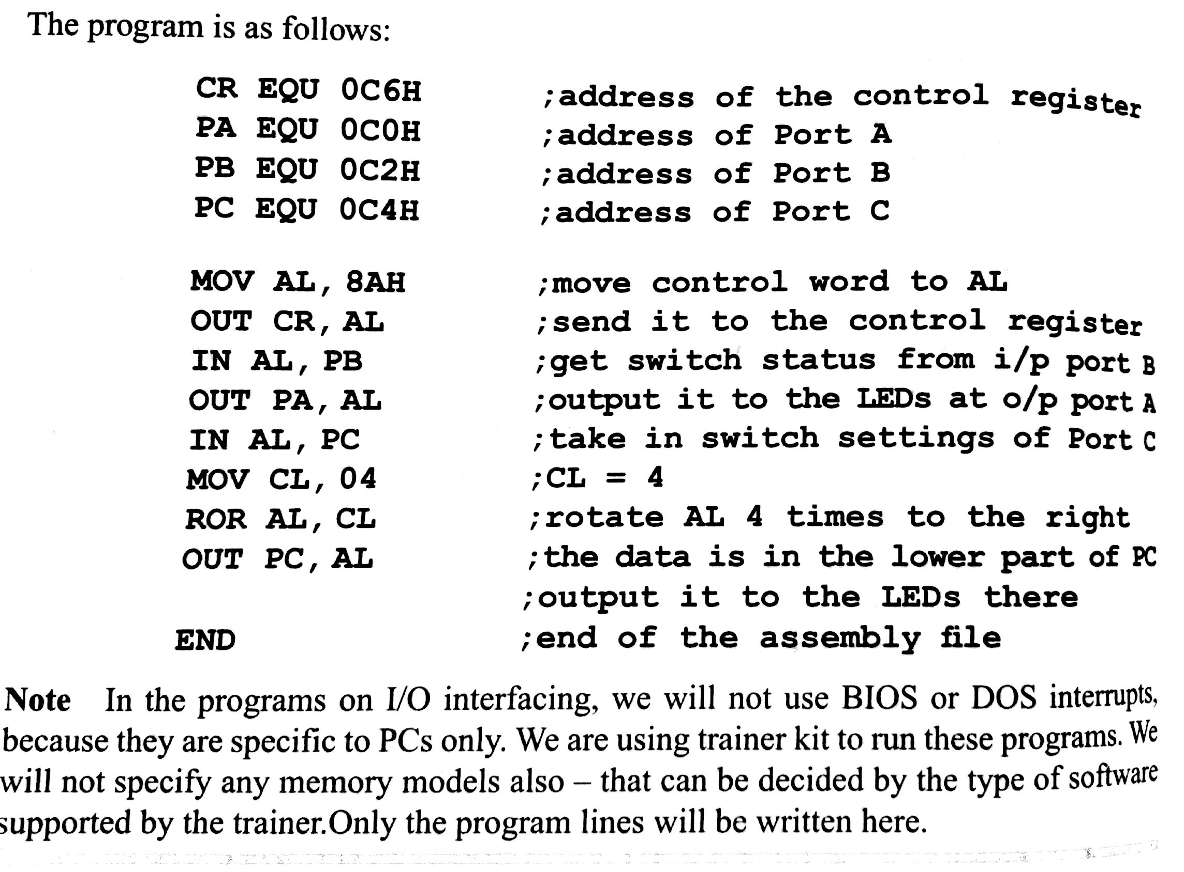
Program

Slide 24
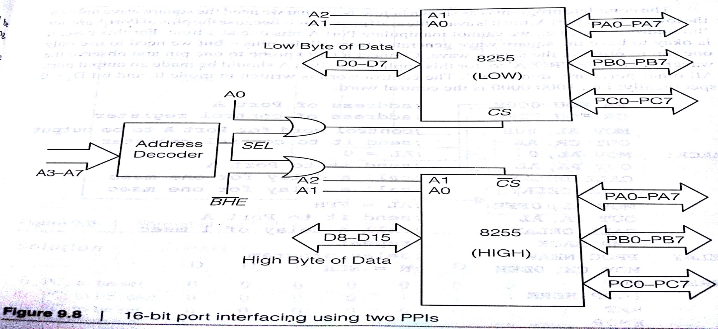
Interfacing 16 Bits I/O ports to the 8255
Above is for a port to which only 8-bit data is to be transferred from D0 to D7 of the data bus of the processor.
Since 8086 has a data bus width of 16 Bits, it is quite possible that it may sometimes need to send/receive 16 bits through a parallel port when the port has a data bus of width 16 bits.

Slide 25
Mode 1
its called handshaking mode
here Port A and Port B can be used for data input or output
bits of Port C are used as handshaking signals to control these data transfers.
mode is referred to as strobed input/output mode also
strobe- indicative of signalling- classically by the use of light
Recollect the grouping into groups A and B
i. Each group contains one 8-bit and one 4-bit port. The port 4-bit port is used for ‘Handshaking’
ii. The 8-bit port can be either an input or an output
iii. Input and Output are latched
iv. The 4-bit port is used for control and status of the 8-bit data port
v. Interrupt logic is supported

Slide 26
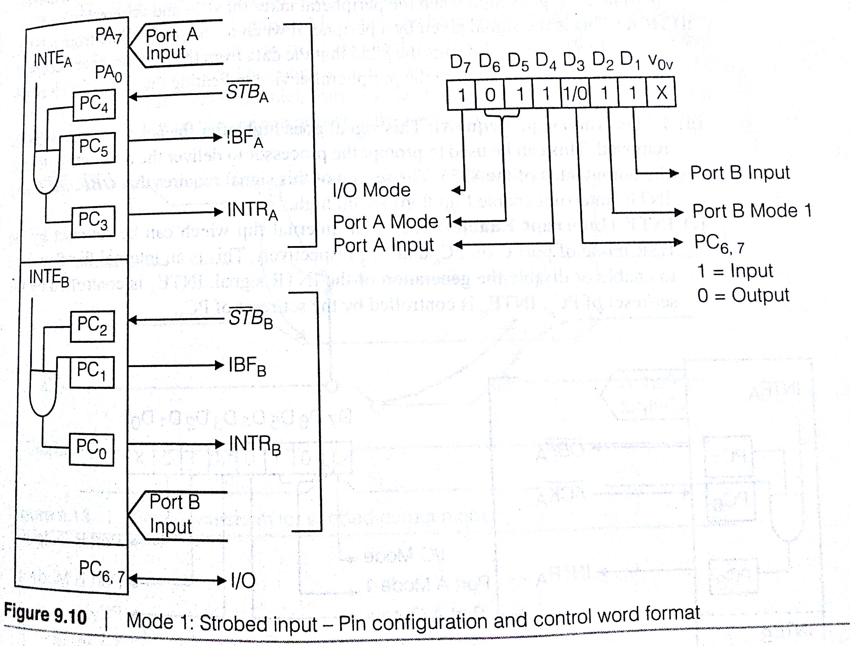
1. Strobed input Mode
figure 9.10 shows the signal definitions of Port C when Ports A and/or B are used as inputs.

Slide 27
STB (strobe) : The peripheral sends a data byte to the 8255, indicates this by lowering the strobe line. This active low signal is given by an input device indicating that it has sent a byte of data to the 8255, which will be latched therein
IBF (Input Buffer Full) : This is the signal the 8255 sends as acknowledgement to indicate that the input latch has received the byte sent by the peripheral. It is set when 8086 reads the data.
INTR( Interrupt request) : A high on this is used to interrupt the CPU. This is set to high if STB is high, IBF is high and the INTE (Interrupt enable) FF is set. It is reset by falling edge of RD

Slide 28
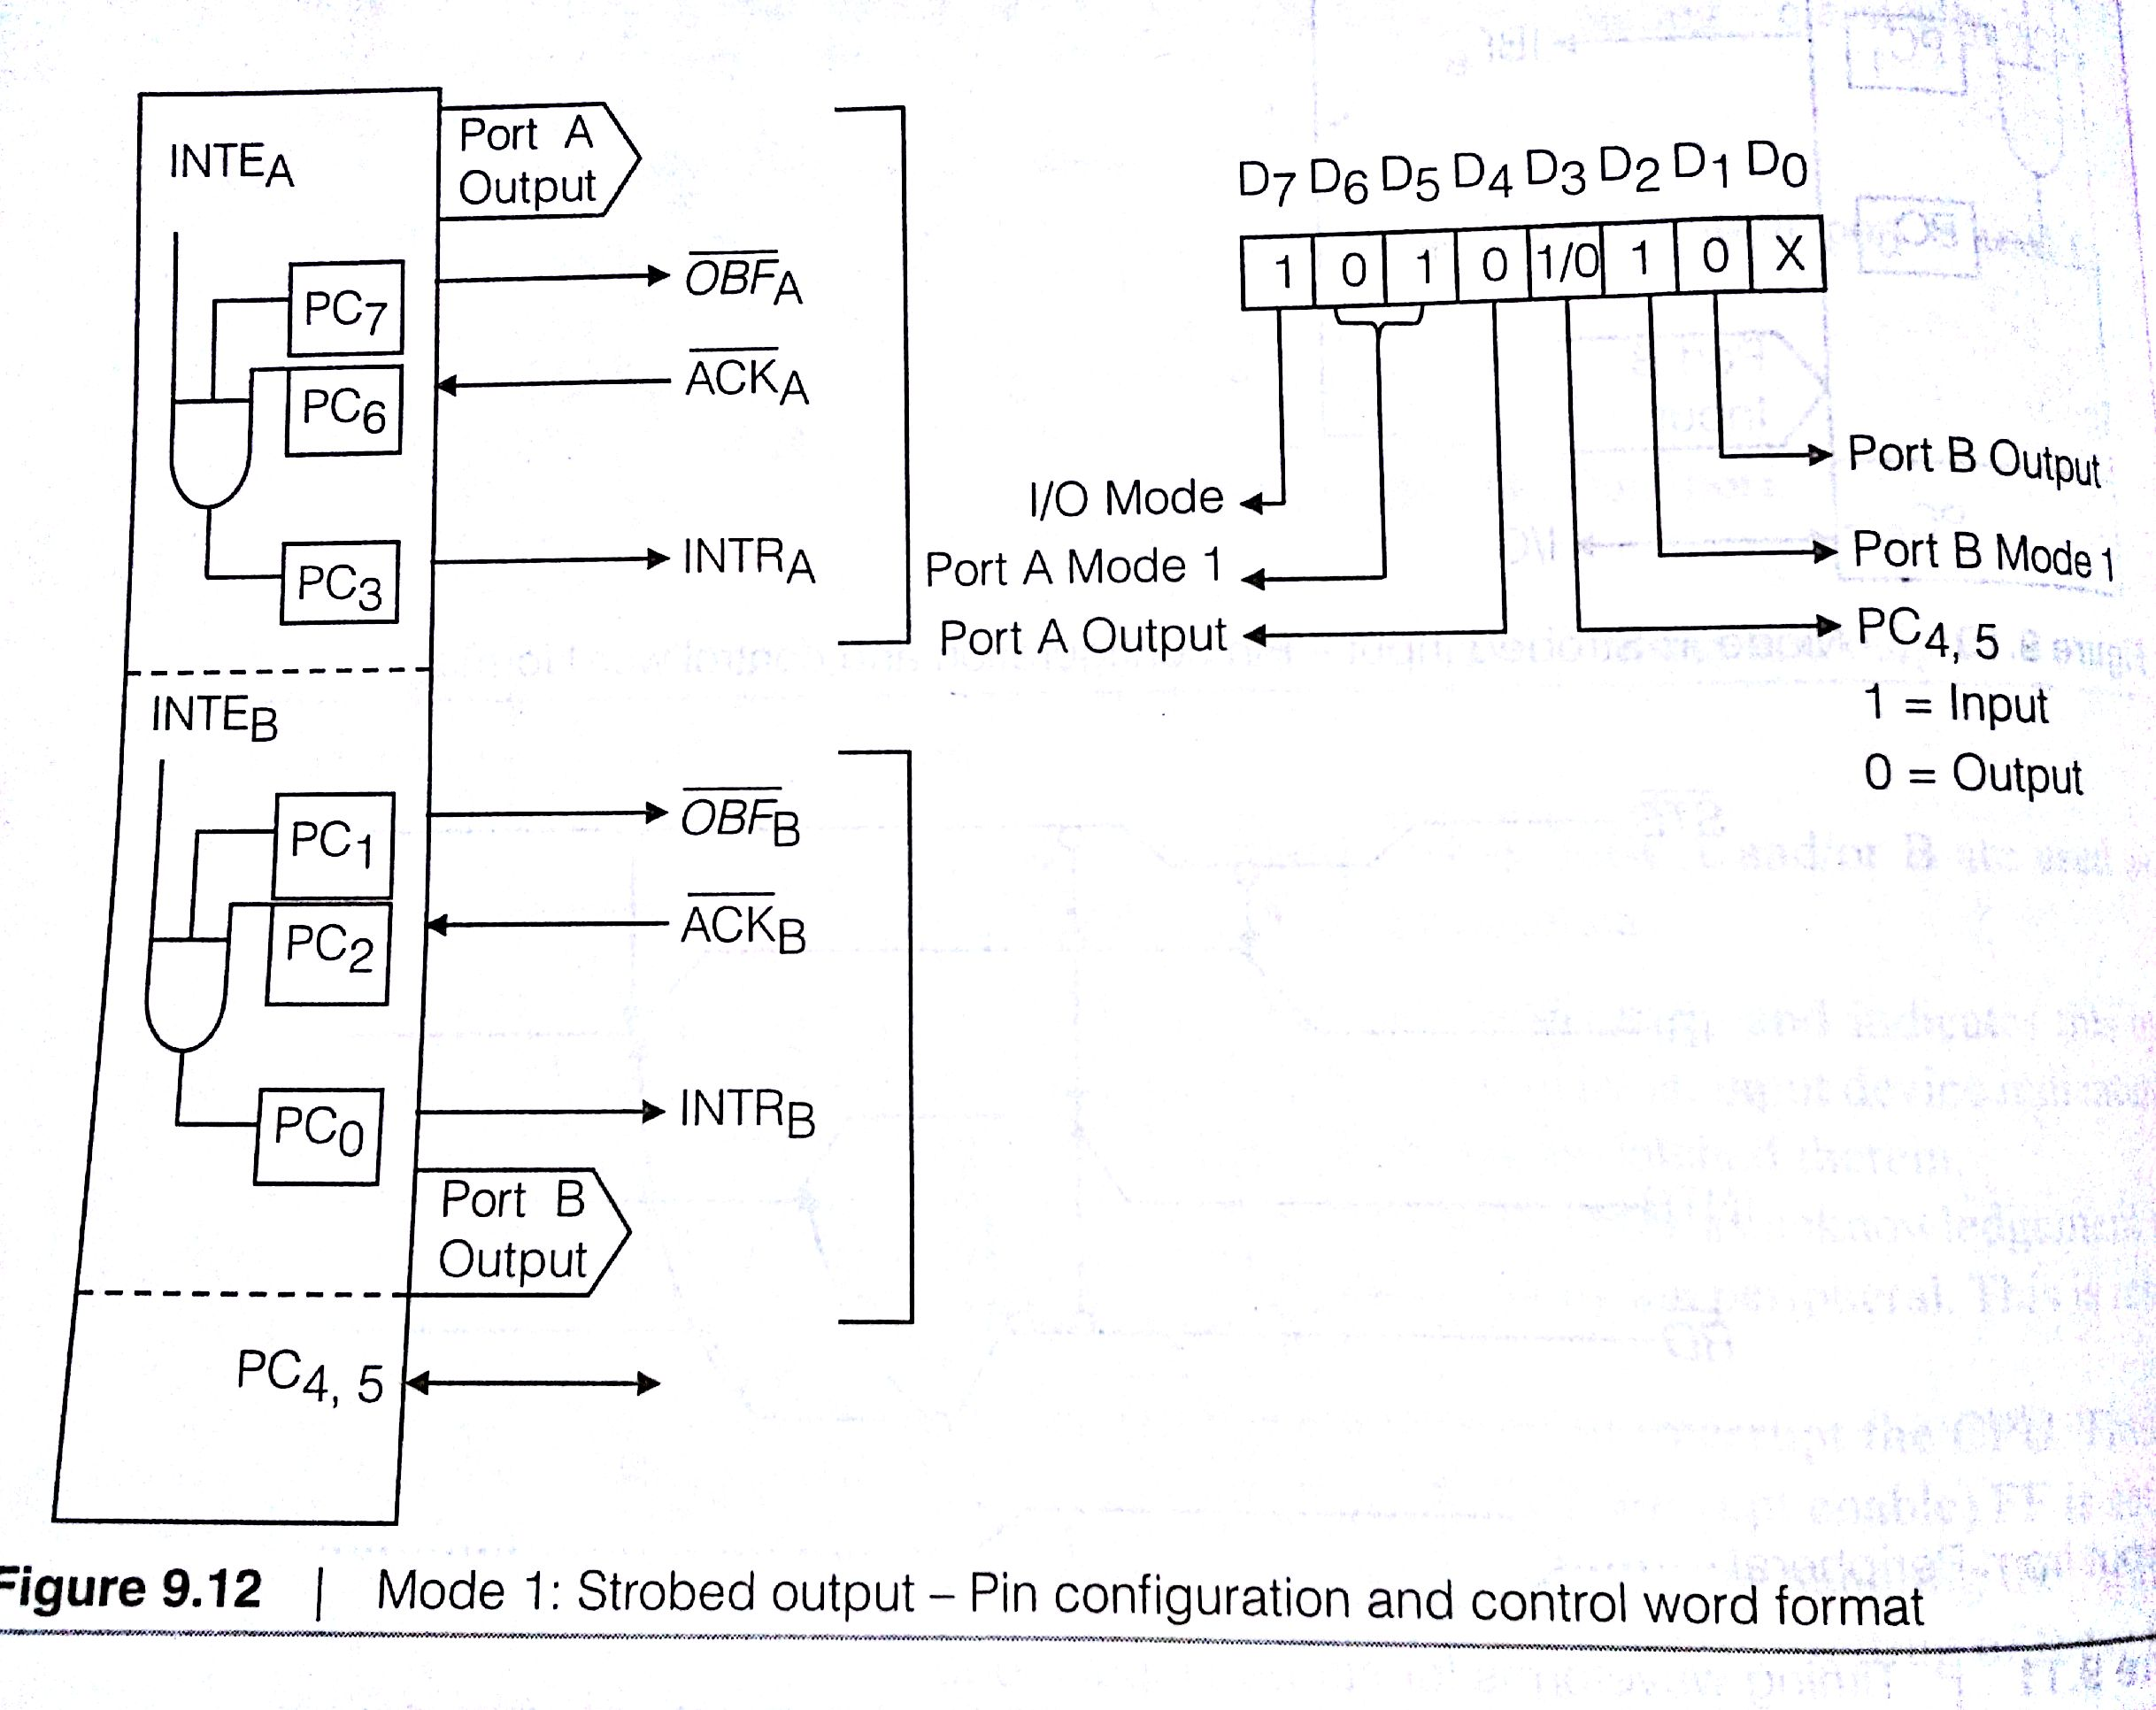
2. Strobed Output
In a similar way, Mode1 output uses the pins of Port C, as shown in figure below.

Slide 29
i. OBF (Output Buffer Full) : when processor writes a data byte to the output latch of 8255, signal goes low. It indicates that this data can be read into the peripheral. It goes high when the peripheral takes the data and acknowledges it.
ii. ACK : This is the signal given by a peripheral when it accepts the data from 8255A. A ‘low’ on this input informs the 8255 that the data from the port has been accepted. In essence, a response from the peripheral device indicating that it has received the data output by the CPU.
iii. INTR(Interrupt Request) : This signals goes high after the acknowledge signal is removed. This can be used to prompt the processor to deliver the next data byte into the output latch of the 8255.
iv. INTE (Interrupt Enable) : is an internal flip which can be set/reset by the BSR mode of port C on PC6 & PC2 respectively. Internal flip flop used to enable or disable the generation of the INTR signal.

Slide 30
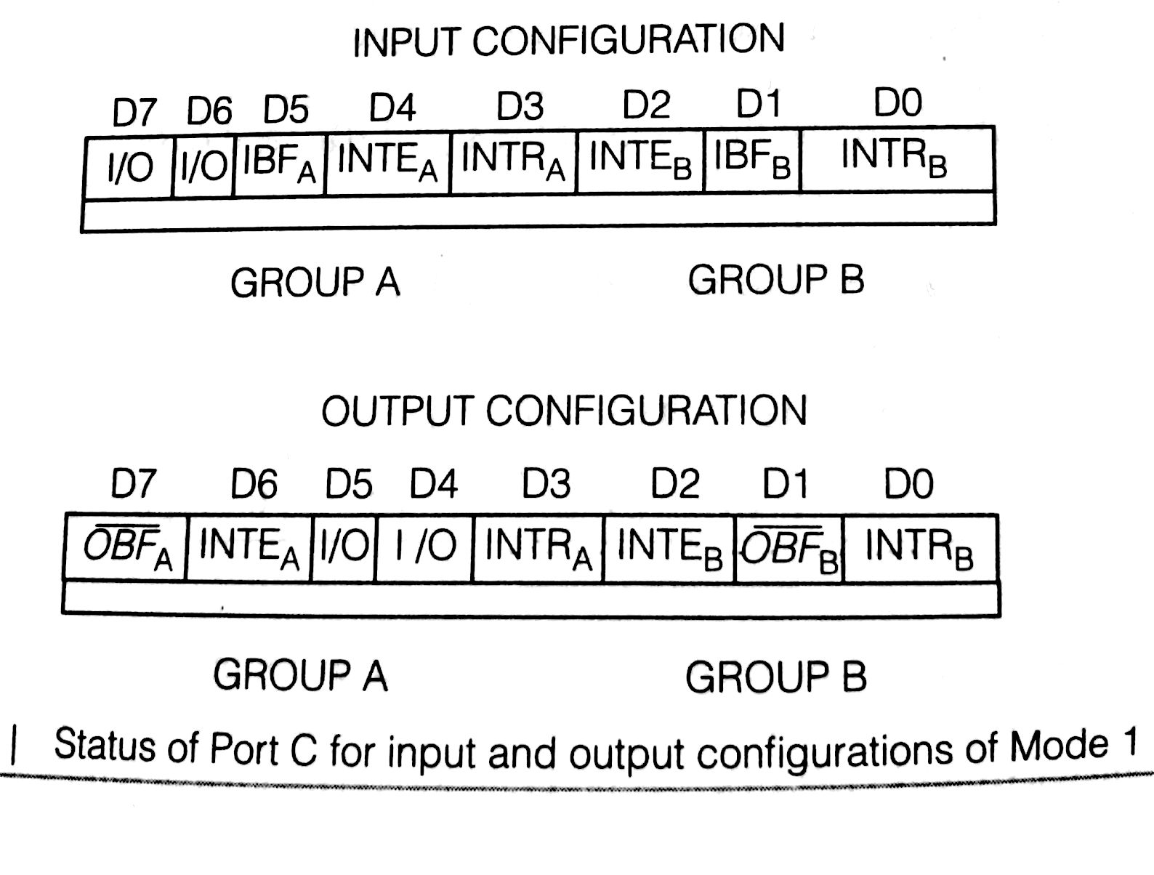
v. In Mode 1, output mode, two pins PC4 and PC5 are not used as handshaking signals . They may be used as input or output lines as desired.
The figure shows the status of Port C for input & output configuration of mode 1

Slide 31
Mode 2 ( Strobed Bidirectional Bus I/O)
configuration provides the mean for communicating with a peripheral device or structure on a single 8-bit bus for both transmitting and receiving data.
Handshaking signals are provided to maintain proper bus flow discipline in a similar manner to Mode1.
Interrupt generation and enable/disable functions are also available
Mode 2 basic functional definitions are:
1. Used in Group A only
2. One 8-bit, bi-directional bus port and a 5-bit control port
3. Both inputs & outputs are latched
4. the 5-bit control port is used for control & status for the 8-bit, bi-directional bus port.

Slide 32
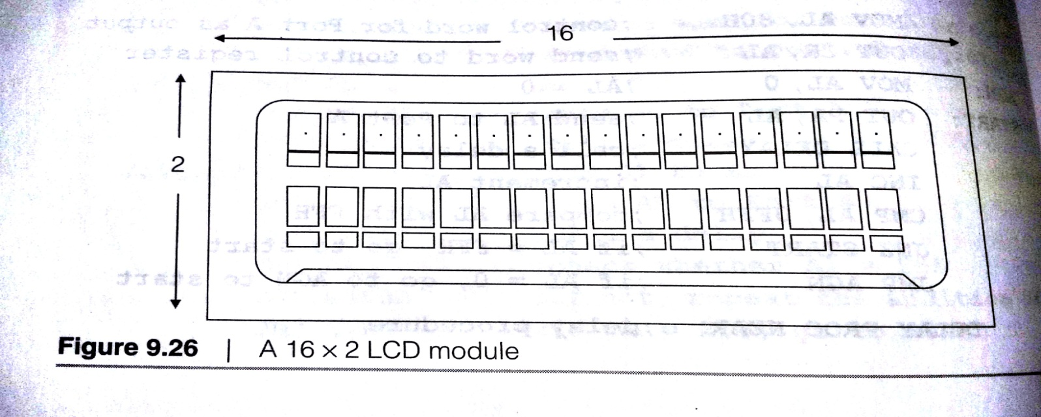
Interfacing Liquid Crystal displays to the 8086
Liquid Crystals Displays (LCDs) are very popular with their qualities of low dissipation and ease of use
problem occurs only with viewing angle
display will not be equally clear in all viewing angles
modules with many different specifications are available
LCD module has registers writing into which the display can be easily programmed and controlled
Here we use a 16X2 character LCD, as shown in below diagram.

Slide 33
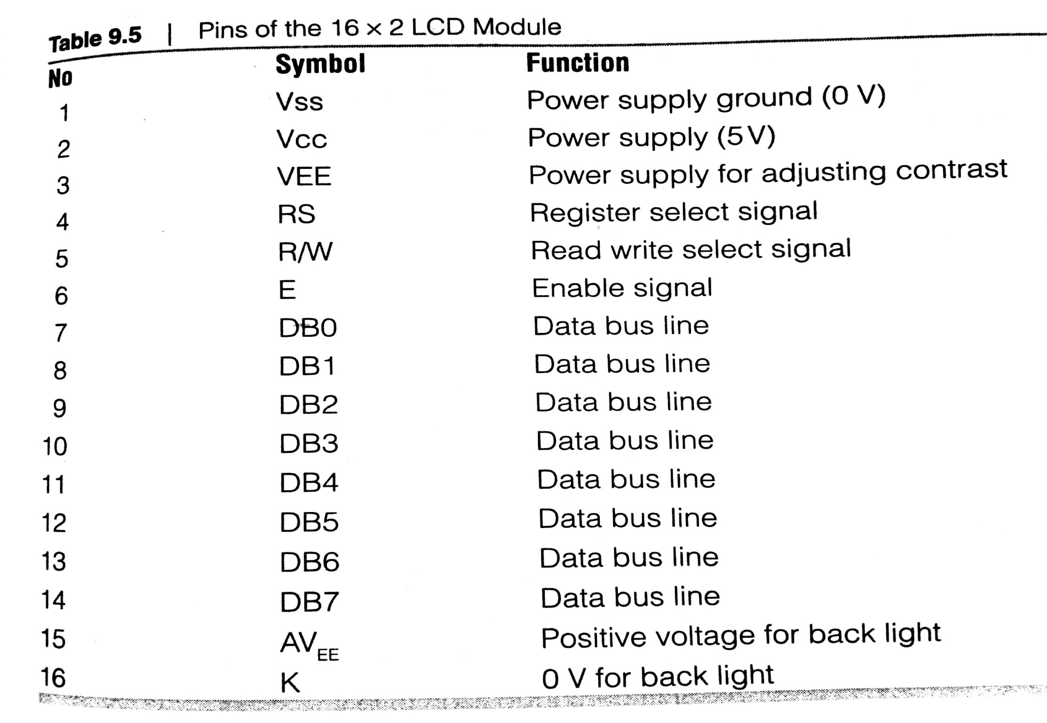
PINS of the LCD
The LCD selected is of 16 pins and its module shown below in table

Slide 34
Here DB0 to DB7 correspond to the data pins
others are for control signals and the power supply
VEE is a pin used to adjust the contrast of the display as connected to potentiometer inorder to adjust the contrast
also pin has VCC and ground
two pins for backlighting, if necessary extra lighting behind the LCD panel, so that the display is visible in dark
RS Register Select pin is selected between command and data register. RS=0 or 1, corresponds to the command and data register respectively. Data to be displayed is sent to data register.
R/W: READ/WRITE pin allows user to read or write to/from display . When no necessity of read the display , the pin is grounded. If both reading and writing is required, this pin is made programmable
E-Enable: enable pin has to be given a high to low pulse, which is maintained high for atleast 450ns

Slide 35
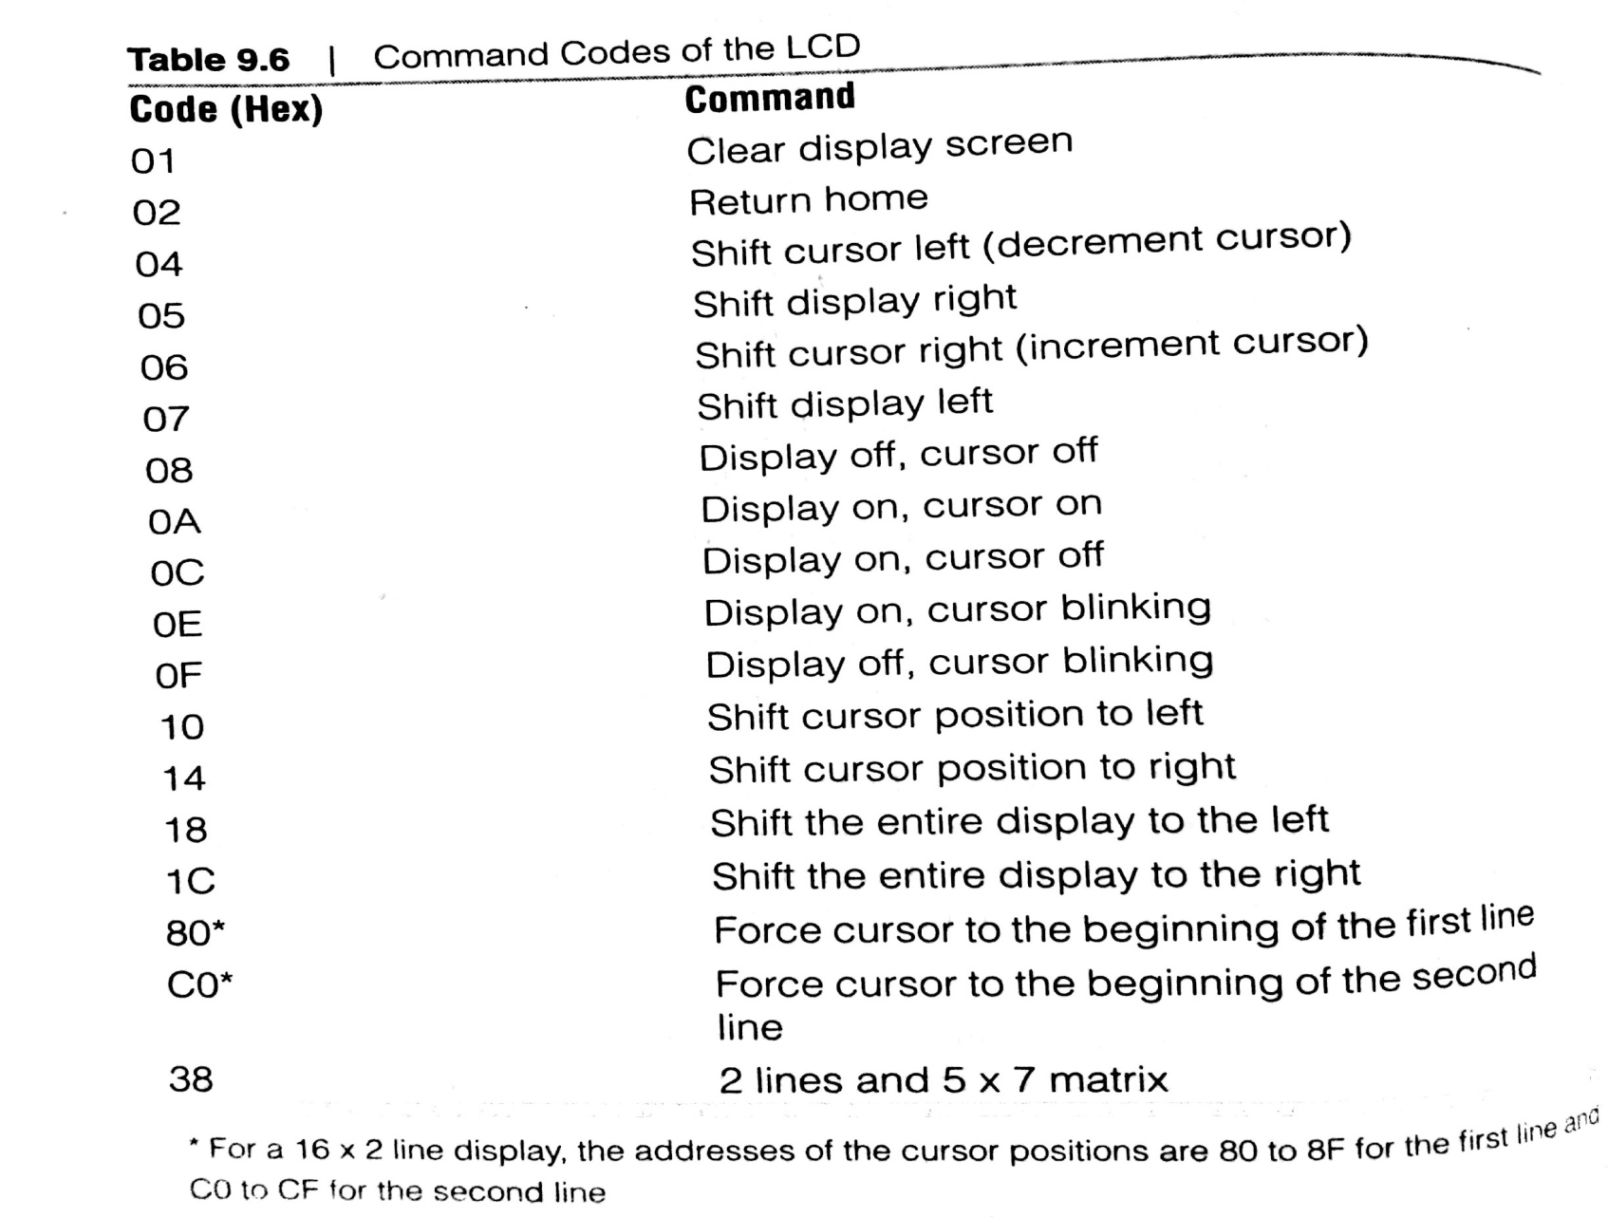
DB0 to DB7 data pins of LCD. Data to send/receive by LCD is through these pins. Data to be written for display are sent as ASCII characters. Writing into command registers, as predefined codes for the LCD using below table

Slide 36
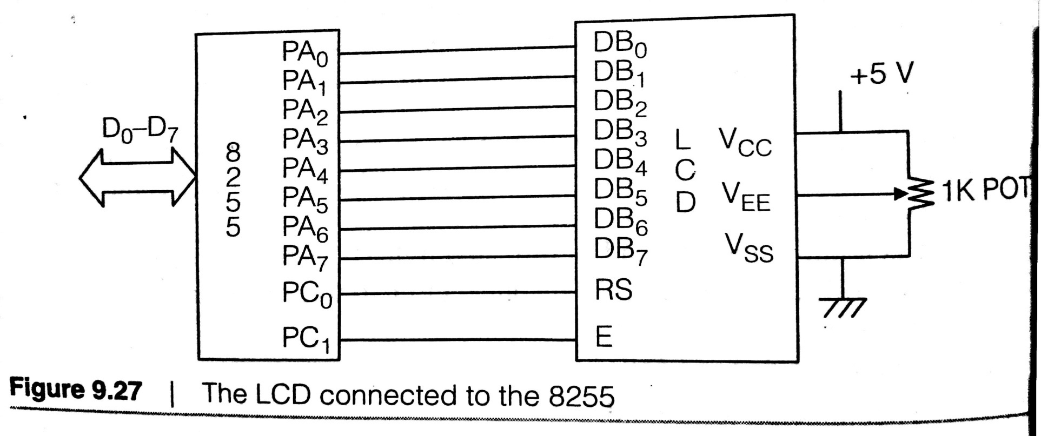
Busy Flag to introduce a small delay between the two data. Busy flag can be made by setting RS=0 first. The busy flag is DB7 and can be read when R/W=1 and RS=0. if DB7 is found high, then it means that LCD is busy in doing its operations and will not accept any new information.
figure shows some display activity using a 16X2 LCD. Data and Command are sent from the 8086, using the 8255 as the interface.

Slide 37
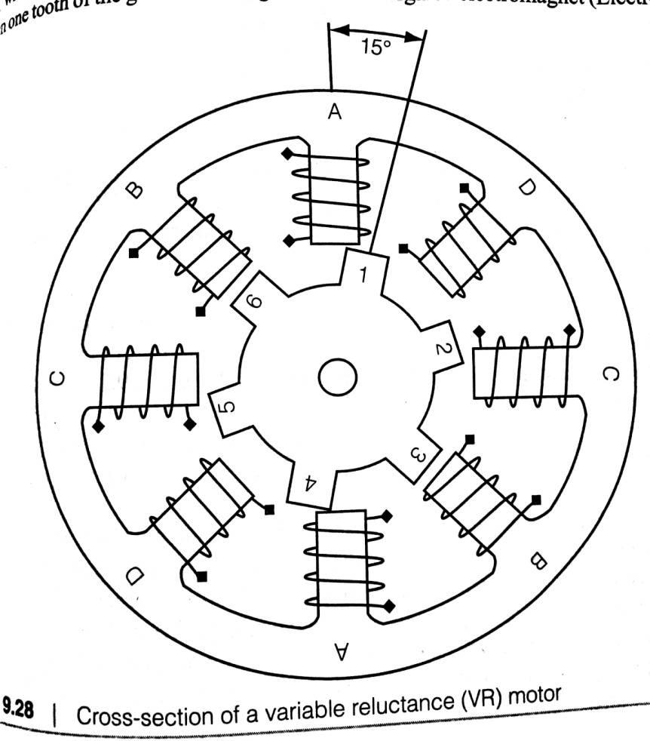
Interfacing a Stepper Motor to the 8086
A stepper motor is an electromechanical device that converts electrical pulses into discrete mechanical movements.
As electrical pulses are applied to it, the shaft of the motor rotates in steps as it is named.
Operation Principle its operation is totally different from normal DC motors
DC motor rotates continuously when voltage is supplied to its terminals

Slide 38
stepper motor has multiple ‘toothed’ electromagnets arranged around a central gear-shaped piece of iron, as electromagnets are energized by an external control circuit that sends pulses to motor. To turn motor shaft, one of the electromagnets is given power first, which makes the gear’s teeth magnetically attracted to the electromagnet’s teeth. When one of the tooth of the gear is thus aligned to the energized electromagnet (electromagnet B and tooth 6 of fig) others are slightly offset from the corresponding electromagnets. when the next electromagnet is turned on and the first is turned off, the gear rotates slightly to align with the next one, and the process continues to repeat.
Each of the slight rotations is called a step with integral number of steps making its a full rotation
The rotation of motor is related to the sequence of the input pulses
i. The order in which a particular sequence is applied decides the direction of rotation (clockwise or anticlockwise)
ii. The speed of stepping depends on the frequency of the pulses applied, higher the frequency, faster the stepping motion.

Slide 39
Stepper motor types
there are 3 basic types of stepper motor
1. Variable reluctance
2. Permanent magnet
3. Hybrid
Variable reluctance is a type of motor consists of a soft iron multi-toothed rotor and a wound stator. When a stator windings are energized with DC current, the poles become magnetized. Rotation occurs when the rotor teeth are attracted to the energized stator poles (fig 9.28)

Slide 40
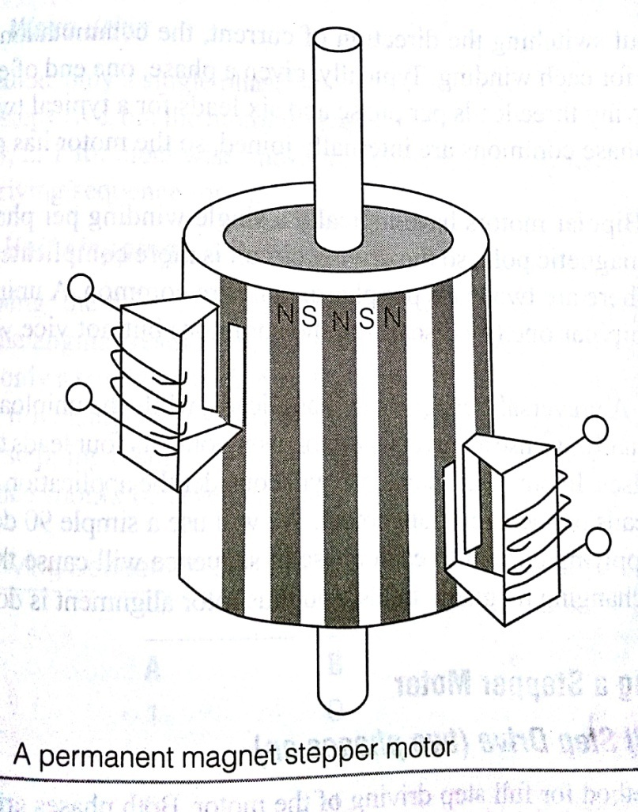
Permanent magnet here Permanent magnet added to the motor structure. Rotor has no teeth but is made with alternating north and south poles of permanent magnets situated in a straight liner parallel to the rotor shaft. As current is applied to each phase in sequence will cause the rotor to rotate by adjusting to the changing magnetic fields. Its operates in low speed, the PM motor has a relatively high torque characteristic.

Slide 41
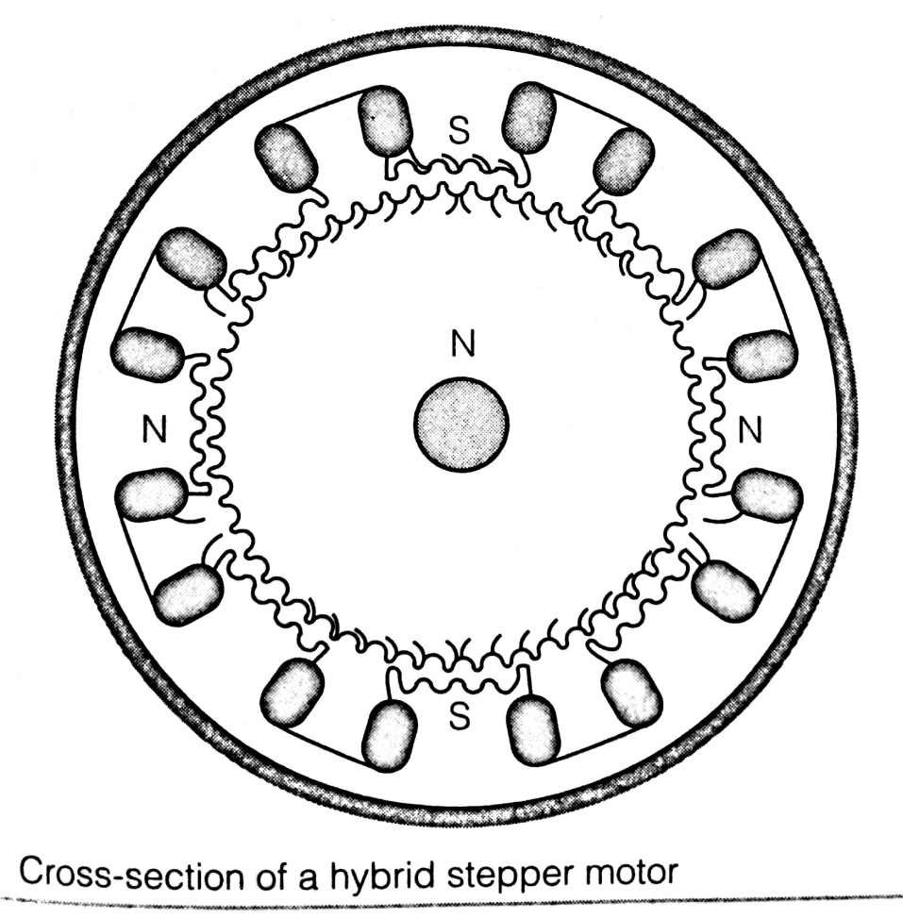
Hybrid combines the features of both PM & VR motors. The rotor is multi toothed like the VR motor and contain an axially magnetized concentric magnet around its shaft. The teeth on the rotor provide an ever better path, that helps guide the magnetic flux to preferred locations in the air gap.

Slide 42
Two-Phase Motors
Based on the winding arrangements for the electromagnetic coils in a two-phase stepper motor: bipolar & unipolar
Unipolar Motors has logically two windings per phase, one for each direction of magnetic field. As magnetic pole can be reversed without switching the direction of current, the communication circuit can be made very simple for each winding.
Bipolar Motors have logically a single winding per phase, reversed in order to reverse a magnetic pole, so the driving circuit is more complicated. Unipolar can be made as bipolar viceversa not possible.

Slide 43
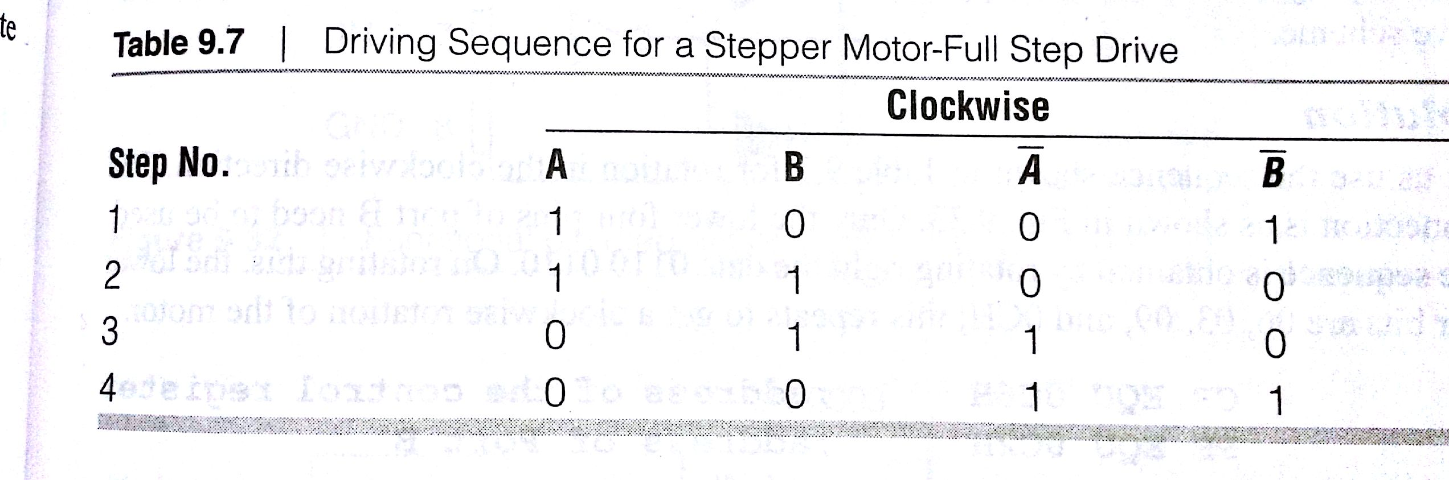
Driving a stepper motor
1. Full Step Drive (Two phases on) usual method for full step driving of the motor. Both phases are always on. Motor will have full rated torque. It is achieved by the sequences of ones and zeroes as shown in table below.
Reversing the order in which the sequence is applied gives anti-clockwise rotation. For clockwise the sequence is 09, 0CH, 06, 03,... For anticlockwise it is 03,06,0CH,09....

Slide 44
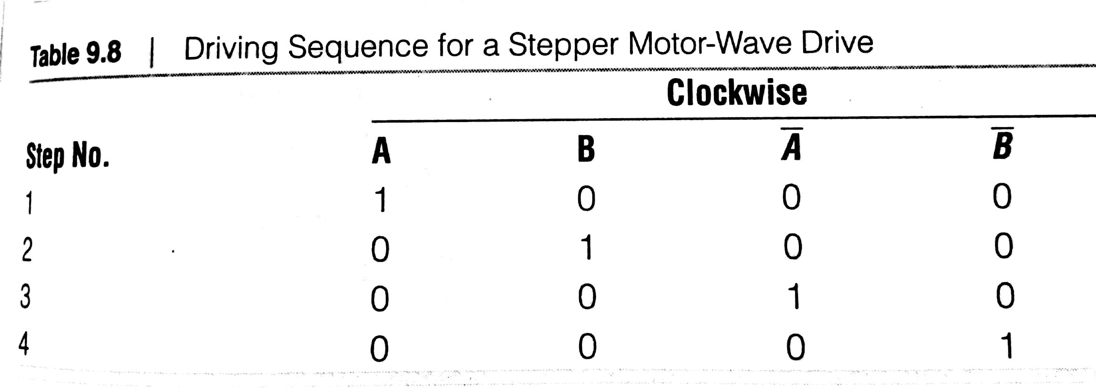
2. Wave Drive in this method only a single phase is activated at a time. It has the same number of steps as the full step drive, but the motor will have significantly less than rated torque. This sequence is 8,4,2,1 for clockwise and 1,2,4,8 for anti-clockwise direction.

Slide 45
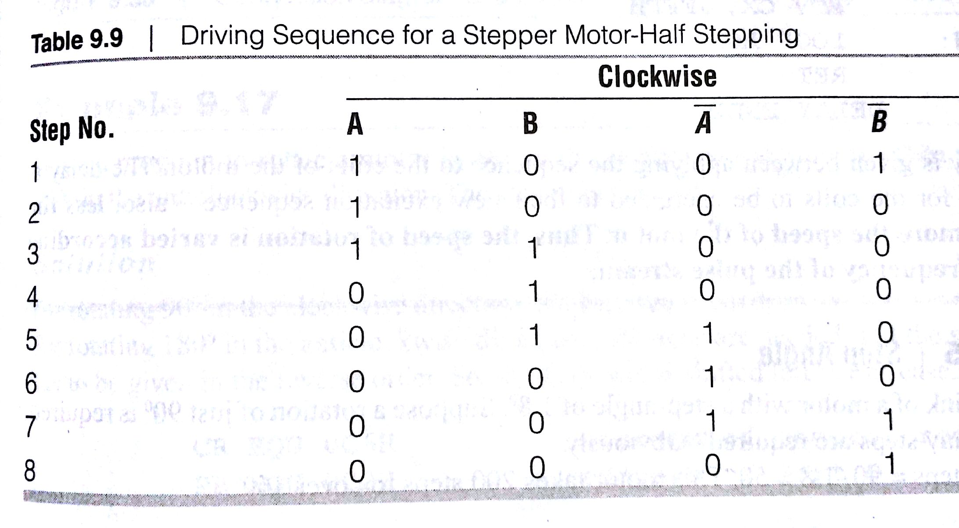
3. Half Stepping drive alternates between two phases on and a single phase on. It increases the angular resolution, but the motor also has less torque at the half step position. Advantage of half stepping is that the drive electronics need not change to support it. Step-angle is half to the previous steps.

Slide 46
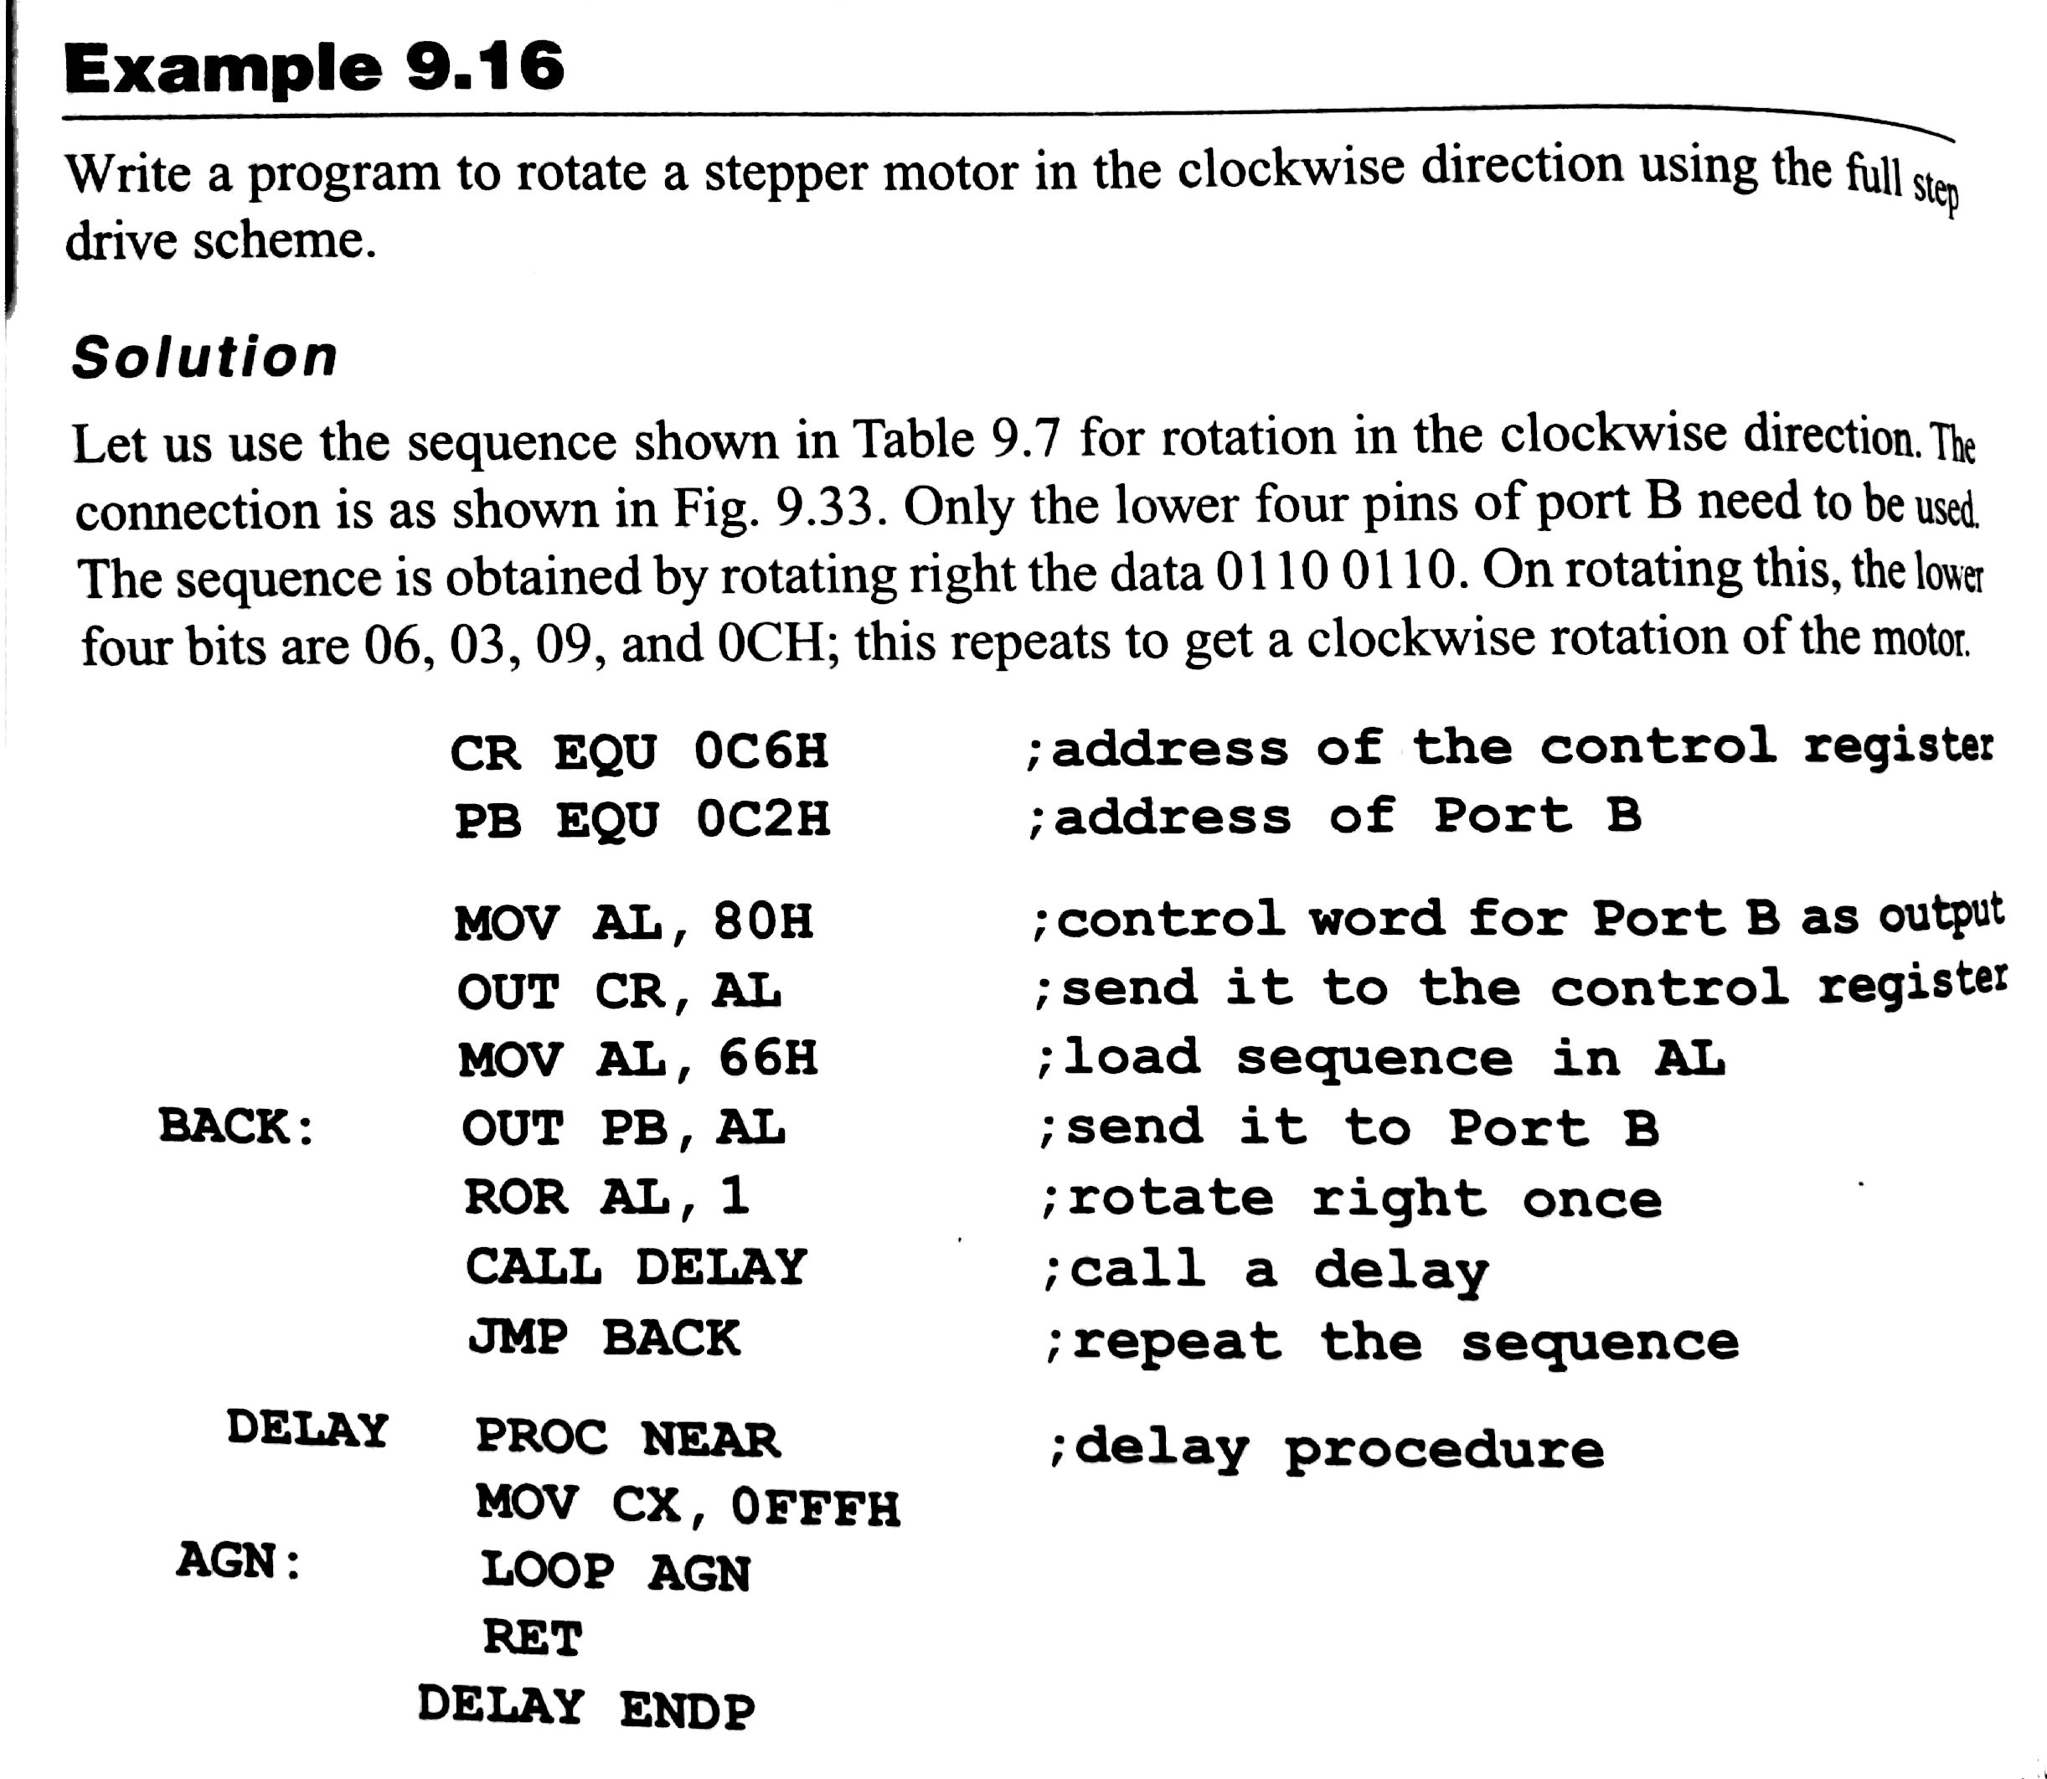

Slide 47
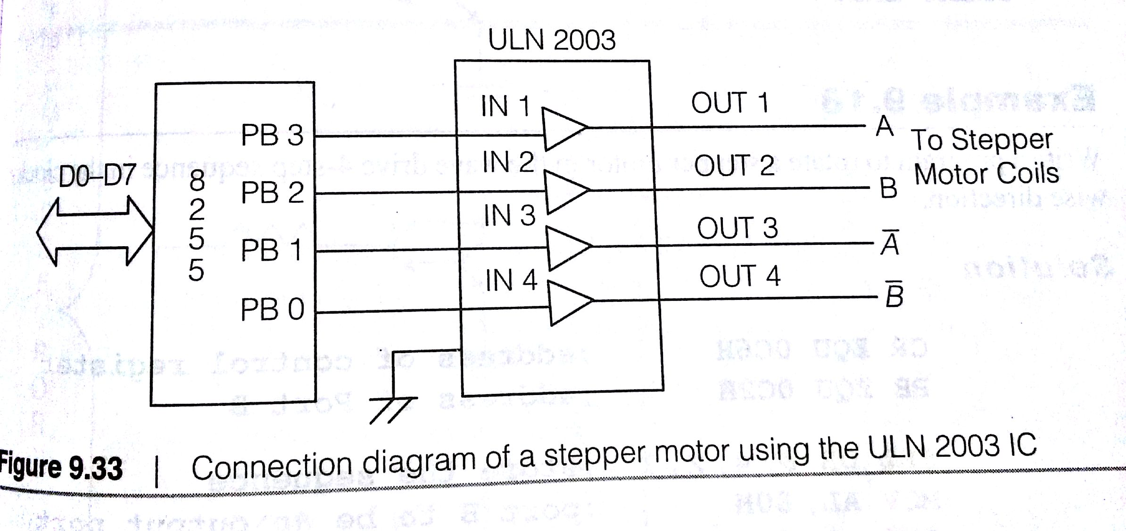

Slide 48
Interfacing an Analog to digital Convertor to the 8086
Real world applications use sensors to get a signal voltage
Eg: for measuring a temperature, a thermometer may be the sensor used.
this gives an analog voltage corresponding to the temperature value.
various sensors measure quantities like humidity, speed and gives the measured values an analog voltages.
to use these values in a computer, these values have to be converted to digital numbers
This is the function of an analog to digital convertor.
many methods are employed in this conversion
various standard ICs available as ADCs.

Slide 49
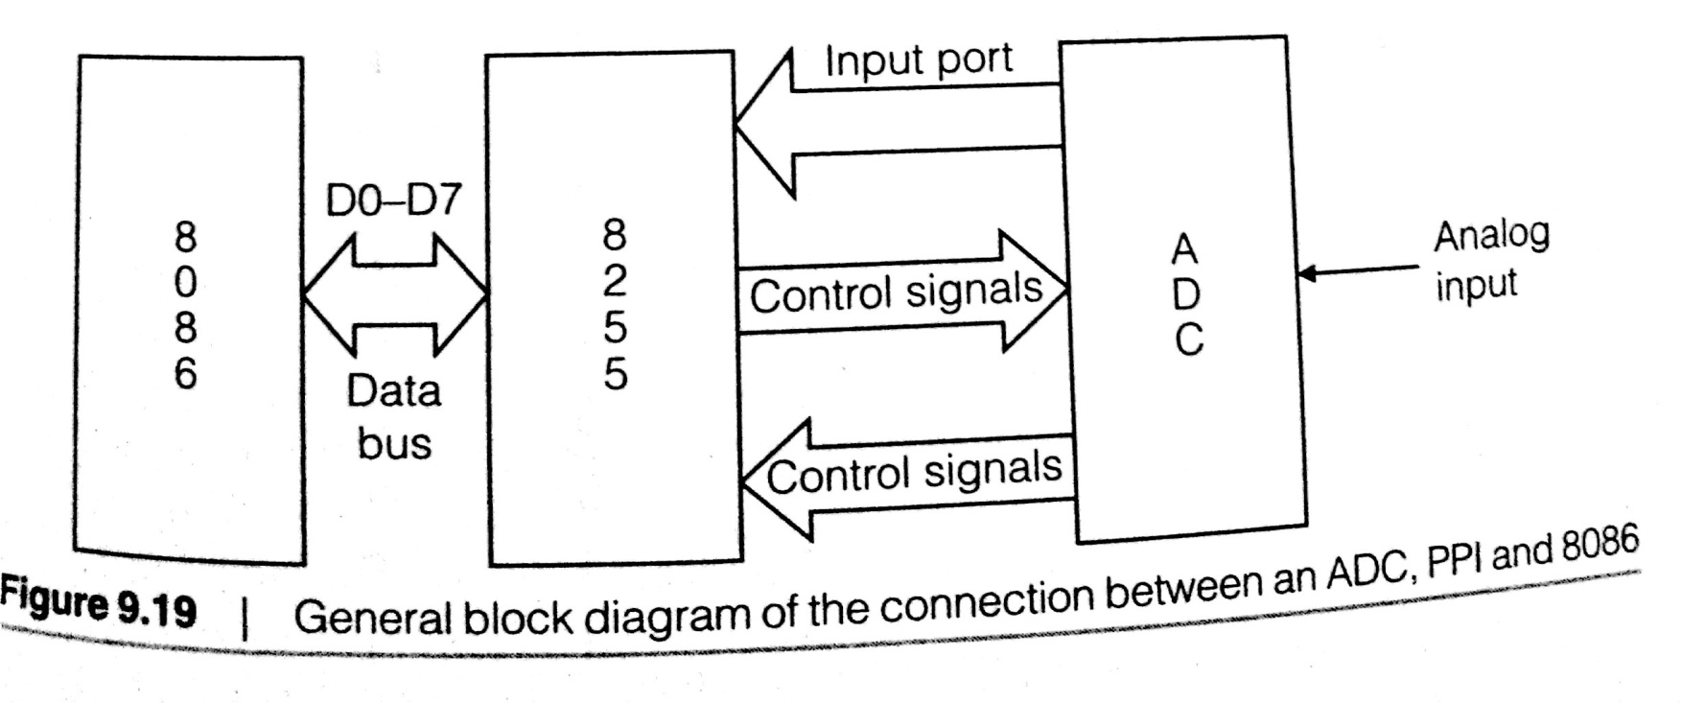
They vary in number of digital output bits, the number of analog inputs & speed of conversion.
Here it is to interface an ADC to the 8086 using the 8255 as an interface
ADCs may be parallel or serial
its an important application for the parallel port IC 8255
As an analog voltage is given as an input to ADC, it gets converted to a digital number whcih is transferred to the 8086
Digital value is stored in RAM of the system and may be displayed or used for further computations

Slide 50
In this 8255 acts as an intermediatory
role of 8255 chip in conversion and data transfer is that the converted digital data from the ADC is transferred to the 8255 with one of its ports acting as an input
This data is sent to the processor through data bus
ADC needs few control signals for its operation
ADC 0808/0809
different methods of analogy conversion and many different standard ADC chips
lets choose ADC0808/ADC0809, which is 8-bit parallel ADC & microprocessor compatible
its functional pin diagram is shown in fig 9.20
it is designated as an 8-Bit Up compatible A/D convertor with 8-channel Multiplexer
it uses the successive approximation technique for analog to digital conversion

Slide 51
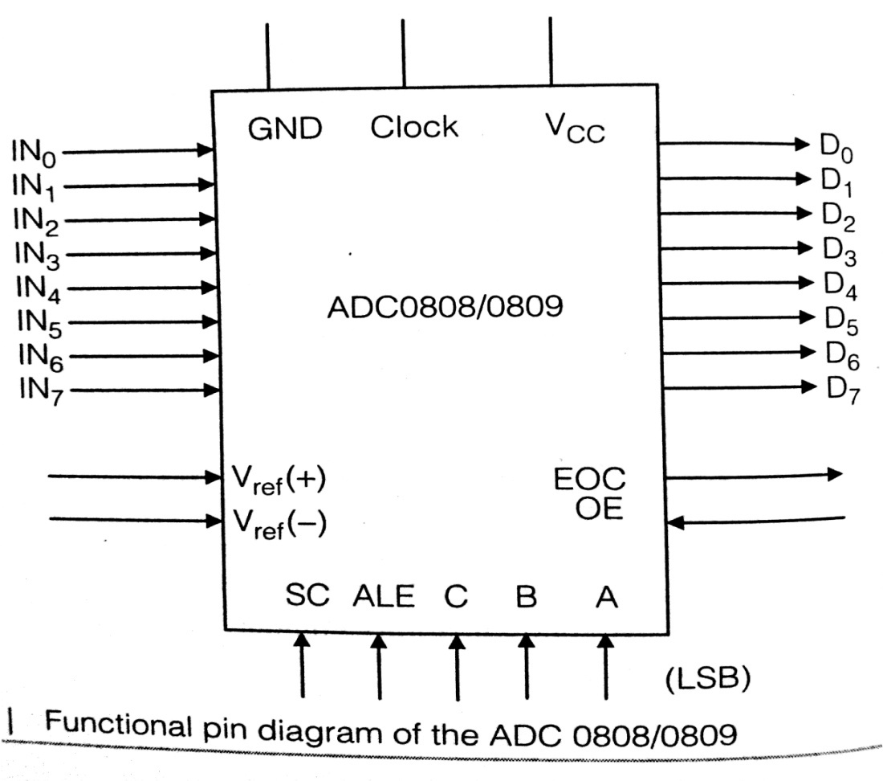
Its key specification are given as:
1. resolution 8 Bits
2. Total Unadjusted error +/- ½ LSB and +/- 1 LSB
3. Single supply 5VDC
4. Low power 15 mW
5. Conversion Time 100 Usecs

Slide 52
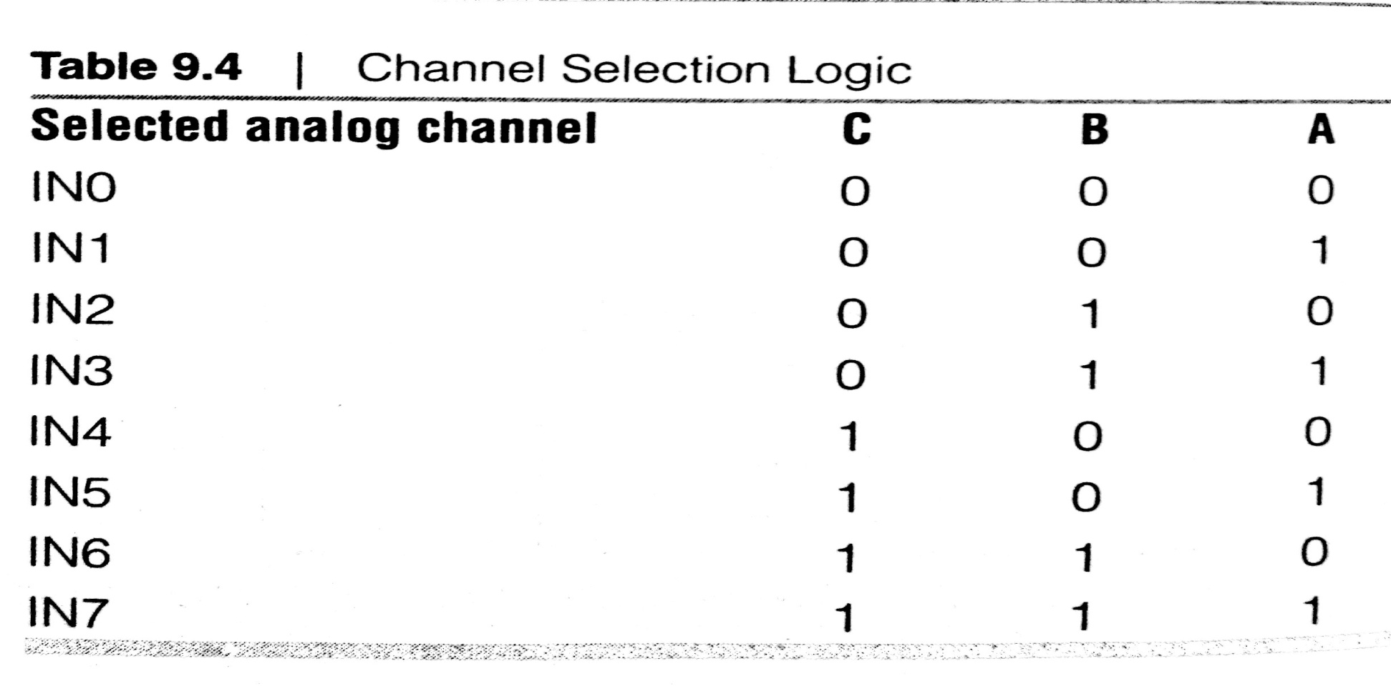
it is an 8-bit multiplexed ADC- which means that it has 8 input analog signal lines, through only one of them can be operational at a time.
It is selected by three address inputs A, B and C
Table shows the address bit configuration for selecting specific input channels

Slide 53
if IN0 is to act as the input, the address lines C, B and A all have too be low
for IN1, the values of CBA is to be 001 and so on.
The first requirement in using the ADC is to select an input channel by giving the appropriate logic on the address pins
to latch on to the chip, a signal called ALE (address latch enable) is to be supplied on the ALE pin
ALE is to be low to high transition
after the address is latched & the analog input is available at the selected input line, the ADC must be signaled to start conversion.
ADC takes a finite time to complete the conversion and then it notifies this fact bby lowering the pin called EOC( End of Conversion)

Slide 54
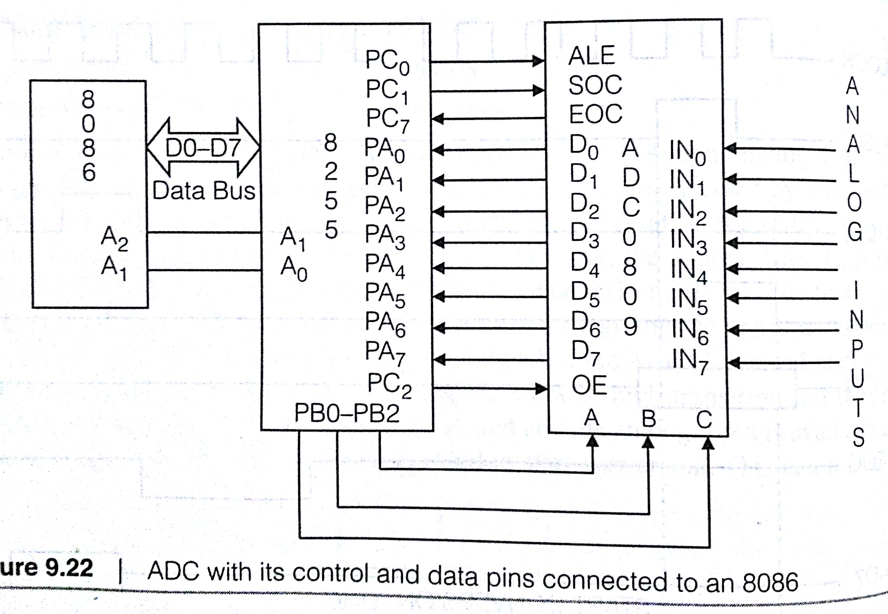
Lets use the pins of 8255 for specific purpose
Make the connections between the 8086, 8255 and the ADC as shown in figure. The salient points regarding the connections are:

Slide 55
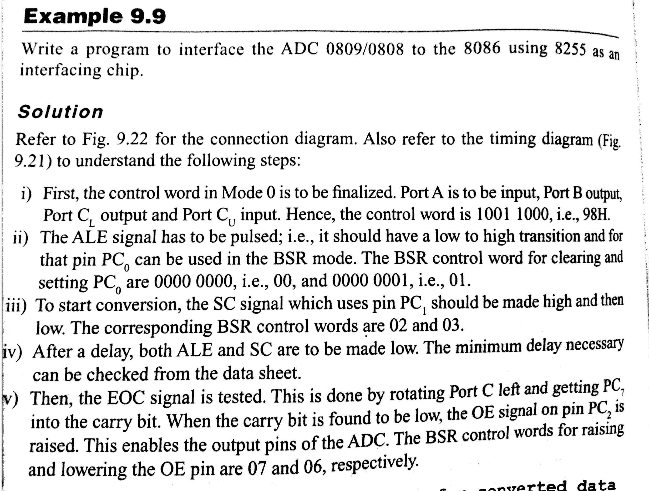

Slide 56
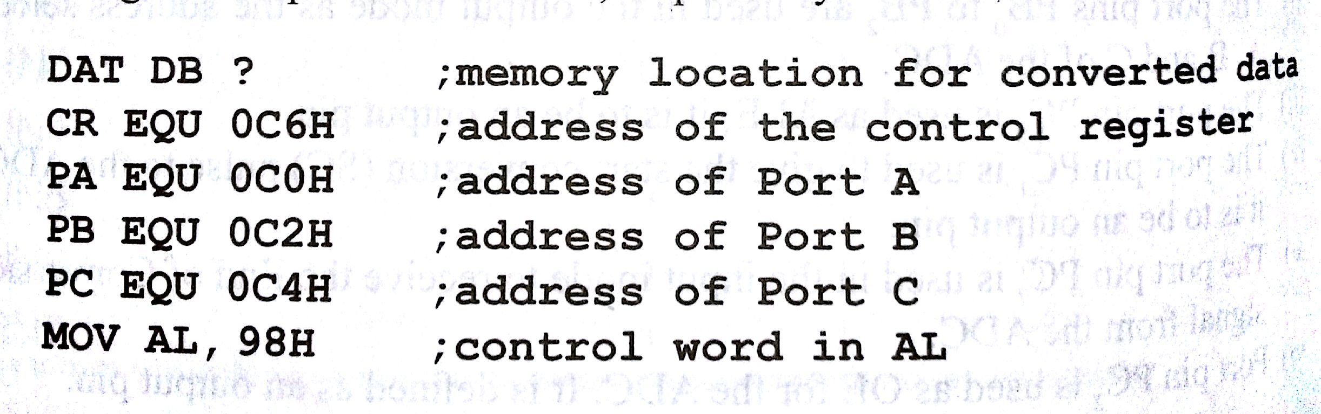
Program

Slide 57
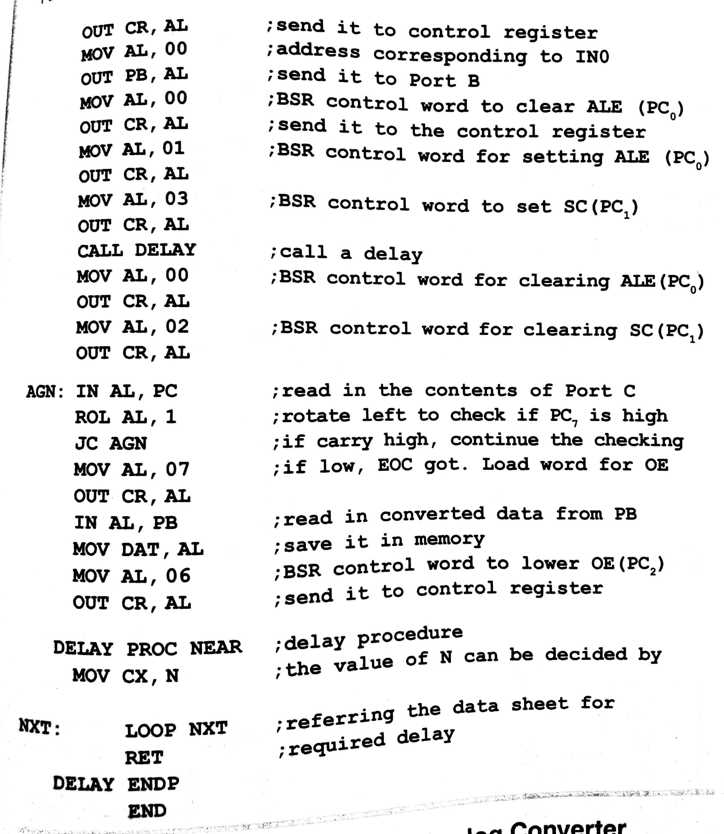

Slide 58
Interfacing to a Digital to Analog Convertor
converting digital number is an important applications in electronics
we use DAC chip and connect it to the 8086 using an 8255 as the interface
digital number sent from the processor is converted to an analog current/ voltage by this arrangement
DACs of different resolution are available- 8, 10, 12 or 16-bit inputs
more number of bits the better resolution
for an 8-bit DAC, the output current I0 is a function of the binary numbers at the data input pins D0 to D7

Slide 59
